Slide 1

SGLines Enterprise Architecture Blueprint
NUS ISS Team 1

Slide 2
Content
Architecture Vision
Business Architecture
Information Architecture
Application Architecture
Technology Architecture
Opportunity and Solution
Migration Plan
Governance

Slide 3
Architecture Vision

Slide 4
Concerns
Stakeholder | Key Concern
Customer | Ability to place order with higher turn around date
CxO | Losing sales? Prevent delay of shipment errors, Higher SLA, Cutting cost
Sales Team | Real time sales order generation, and faster feedback from RFQ, Improve Up time for VMS and CMS, at the same time improve customer service level through usage of technology
Order Processing Team | To have real time checking on vessel availability and container availability
IT and Operations | Sceptical on the investment of the new IT business goals, as they have no confident on the new system and technologies
Container Management Team | To have better recorded network with tow head operator, and hope could improve the efficiency of the local tow head operators. Current operation take too long to query a certain information from local tow head operator

Slide 5
Business Vision
Restructuring and reorganising the processes
Improvement in terms of revenue and operating profit
Modularity within department
Shared services / Information across multiple department

Slide 6
Change Drivers & Opportunities
Increase Operation Profit
Traceability of cost, network, and shipping movement
Losses of sales revenue
Usage of ecommerce
Cluttered business process flow
Underutilized computer resources
Poor support of current IT structure
Information availability and readiness
Service Oriented Architecture
Use of standard interface data format

Slide 7
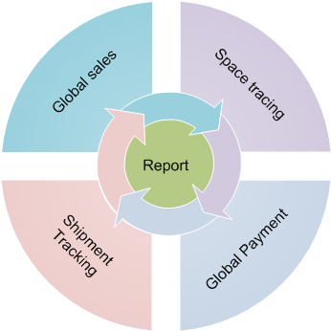
Environment and Process Models
Global Sales , where it handle all the sales from internal staff or external customer
Space Tracing ¸ for vessel and container availability with the predefined routes and calculation of the most effective cost
Global Payment , that handle the payment from customer and billing from third party vendors. The process will handle in multiple currency
Shipment Tracking to ensure the success and prevent losses of every delivery

Slide 8
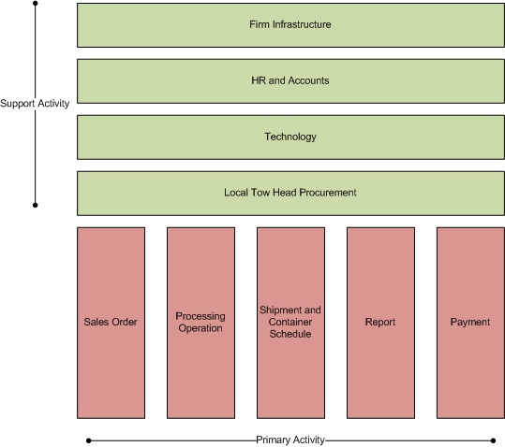
Value Chain Diagram

Slide 9
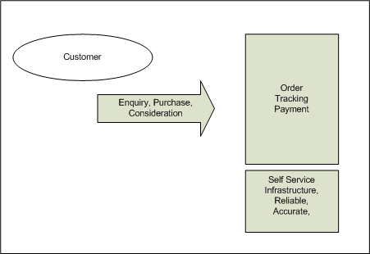
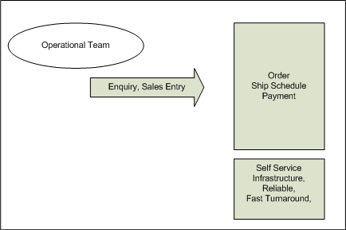
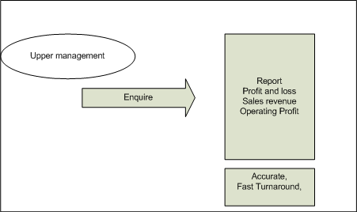
Solution Concepts

Slide 10
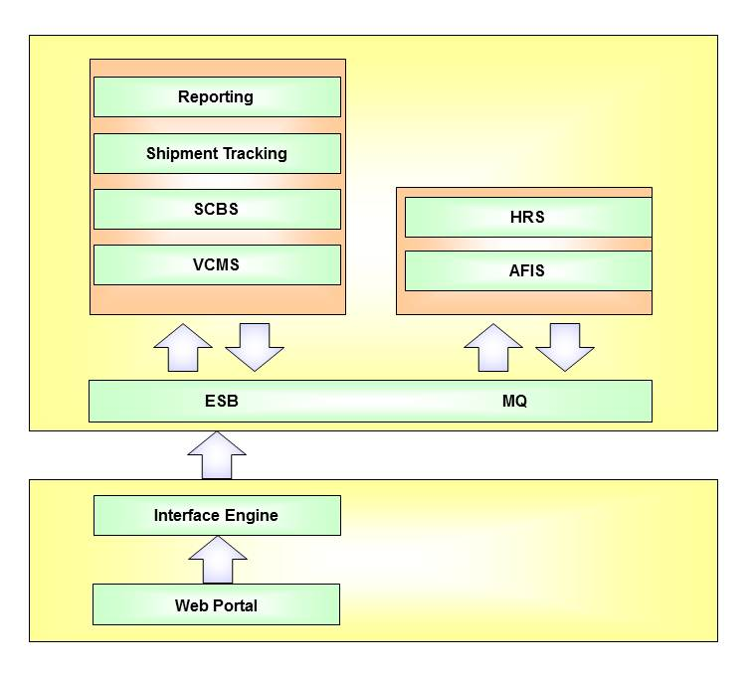
Target Architecture Model

Slide 11
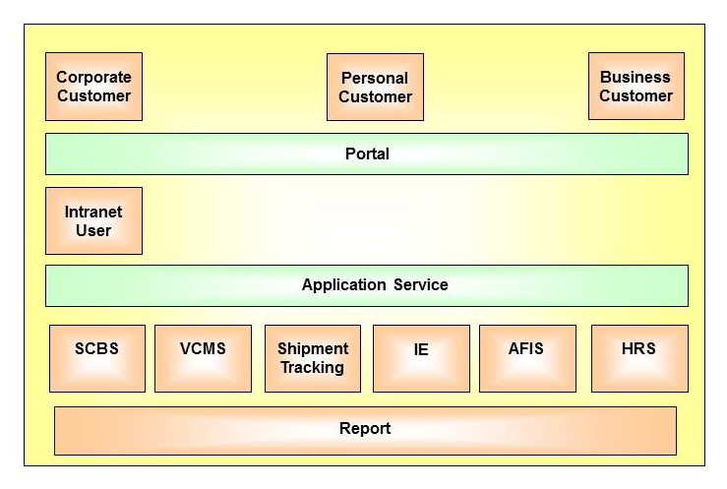
Architecture support process

Slide 12
Constraints
Staff skill set
Transition period for critical system
Infrastructure capability
Information exchange between local horizon office
Internal Politics
Budgeting

Slide 13
Business Architecture

Slide 14
Key Factors
To achieve greater internal business process efficiency, through process integration and better use of its IT systems
System consolidation and integration (SCBS, VCMS)
Web store front order
Service Oriented Architecture
To take full advantage of the Internet and broaden the existing customer base
Online order submission and status checking
Integration with customers’ procurement system
To improve the overall customer experience and customer service
To use e-business to establish a more effective manner for the business processes to integrate with company’s suppliers’ IT systems

Slide 15
SWOT (1)
Strengths | Weakness
Has regional headquarters and transhipment ports worldwide Has AS400 server which provides adapters for MQ series and a Java API Has high-end WinTel servers and VMS AND CMS currently running Has clear business goals | Many Human activities involved will cause errors Little corporate guidance and knowledge cost on engaging with local tow-head operators Different port operators to run their own optimization algorithm which resulted in poor space utilization Manual intervention of customer RFQ, There is a request on RFQ is done directly by customer through internet Loss of sales due to unanswered phone call Legacy system which not supported by existing vendor Multiple role for a particular staff, if staff is unreachable, it will cause undesired delay Delay and missing shipment schedule , resulted in SG Lines make a loss to recover from the damages Manual Calculation and update into SOS system 10% to 15% of unscheduled down time , even though it is mission critical system Multiple integration with different system and underutilize artifacts Some staff not willing to change to the new architecture redefinition

Slide 16
SWOT (2)
Opportunities | Weakness
Integration with port operators for optimization operation Has website which gets 2000 hits per days (possible additional business) | Decline in business due to global economic recession Increase competition Mission Critical System New process and applications

Slide 17
Financial
Customer
Strategy Map
Internal Process
Long-Term Shareholder Value
Maximize traditional revenue sources
Increase asset utilization
Reduce operational cost
Enhance customer value
Customer Value Proposition
Learning and Growth
Price
Quality
Availability
Features
Service
Partnership
Product / Service Attributes
Relationship
Operational Management Process
Customer Management Process
Regulatory and Social Processes
Provide premium service to delight and retain valuable customers
Working environment (Safety and Health)
Consistently deliver the full value proposition
Maximize efficiency and quality of business processes
Maintain existing relationships
Employment
Identify and recognize high-potential relationships
Risk Management
Community
Human Capital
Information Capital
Intellectual Capital
Relationship Capital

Slide 18
Business Reference Model
Services (Vertical)
External: Customers, Port Operators, Tow head operators, Sales team, Order processing team
Online order Submission
Order status checking
Integration with Procurement system
Port operator management
Services (Horizontal)
Order processing
Vessel and container management
Summary reports generation
Information Technology management
Human resource management
Organization & development
Internal: SGLines Staff
Finance
Administrative services

Slide 19
Strategy Outcomes
Performance
Reference Model
Mission and Business Results
Customer Results
Services for customers
Services for partners
Staff services
Management reporting
Customer Benefit
Service Quality
Service Accessibility
Service Coverage
Value
Process and Activities
Financial
Vessel and Container
Customer Relationship
Partner management
Secure Infrastructure
Quality
Value
Human Capital
Technology
Other Fixed Assets
Domain knowledge
Staff development
External consulting
Recruitment
Financial
Quality & Efficiency
Information & Data
Reliability & Availability
Asset Utilization
Regular asset checking
Asset procurement
Inputs

Slide 20
Operating Model - Coordination
Shared customers worldwide
All data are shared across different systems and units.
Operationally similar business units, however regulations and rules may change from region.
Each department manages their own IT systems which are not integrated with each other and not integrate with HQ.
Web site is not integrated with SGLines’ other IT systems although it gets 2000 hits per days.
Long time to implement even simple changes due to lack of internal resources.
Even Business-critical systems in individual factories have unscheduled downtime of average 10% to 15%.
Existing systems do not scale according to the business growth.
Main target is to provide efficient and quality process with competitive price.

Slide 21
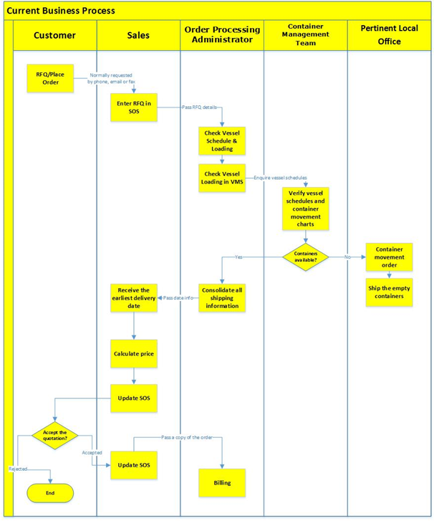
Current
Business Process
Customer Sales and Billing

Slide 22
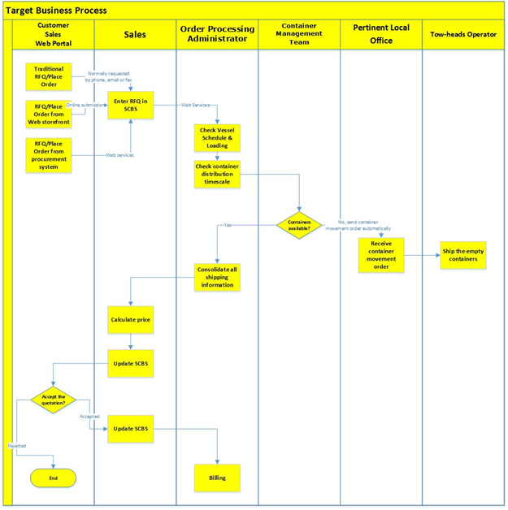
Target
Business Process
Customer Sales and Billing

Slide 23
Gap Analysis
Gap | Description | Current State | Future State | Importance/Benefit | Address by Architecture
Gap 1 | Online order submission and tracking | Customer RFQ through email, fax and phone | Customer RFQ or order is placed through web storefront | Main business entry point Customer satisfaction and process efficiency | Information/Application
Gap 2 | Integrated e-Business with partner and customer’s IT system | Customer RFQ through email, fax and phone | Automated order process with customer 's procurement system | Enhance partner and customer relationship | Information/Application
 |  | Different port operators to run their own optimization algorithm which resulted in poor space utilization | Web services provided by VCMS to optimize container movement and placement
Gap 3 | Sales and Customer Billing System | Separate Sales Order system and Customer Billing System | Integrated Sales and Customer Billing System (SCBS) | Accurate reporting to management Reduce human errors in the original process Streamline the business process to improve service quality | Information/Application
 |  | RFQ/Order manually processed | Online order submission and tracking
 |  | Order pricing manually calculated | Integrated Sales and Customer Billing System (SCBS)
 |  | Customer billing is manually prepared and triggered by order processing administrator | Customer billing is automatically prepared and sent by SCBS
 |  | Quotation or order status are manually changed by sales team | Quotation or order status are automatically updated by SCBS
Gap 4 | Vessel Movement System and Container Movement System | These 2 systems in individual factories have unscheduled downtime of average 10% to 15%. | Centralized Vessel and Container Movement System (VCMS) should have high levels of redundancies to ensure 24 x 7 operations | Ensure high availability for mission critical system to reduce business lost | Information/Application
Gap 5 | Centralized report generation and data management | Inaccurate sales report and transaction data due to human activities | SCBS will access VCMS’s transaction data and produce management reports | Reports are a very useful method for keeping track of important information. The information contained in reports can be used to make very important decisions that affect our lives daily. | Information/Application

Slide 24
Information Architecture

Slide 25
Data Principles
Name | Data Integration
Statement | Data is defined consistently throughout the company, and the definitions are understandable and available to all users
Rationale | With integration between applications, it will allow quicker business turnaround times.
Implications | Multiple data standardization initiatives need to be co-ordinated.
Name | Data Replication
Statement | Data to be replicate and assessable without interrupting online transaction
Rationale | For efficiency and effectiveness in decision-making and service delivery.
Implications | Data is should be sufficiently, able to meet a wide range of requirement.
Name | Data is an Asset
Statement | Data is an asset that has value to the company and is managed accordingly
Rationale | The purpose of data is to aid decision-making.
Implications | Stewards must have the authority and means to manage the data for which they are accountable

Slide 26
Current Conceptual Data Model

Slide 27
Target Conceptual Data Model

Slide 28
Application Architecture

Slide 29
Application Principles
Name | Ease-of-use (Business Principle : Enhance customer value)
Statement | Applications are easy to use. The underlying technology is transparent to users, so they can concentrate on tasks at hand.
Rationale | The more a user has to understand the underlying technology, the less productive that user is. Ease-of-use is a positive incentive for use of applications. It encourages users to work within the integrated information environment instead of developing isolated systems to accomplish the task outside of the enterprise's integrated information environment. Most of the knowledge required to operate one system will be similar to others. Training is kept to a minimum, and the risk of using a system improperly is low.
Implications | Applications will be required to have a common "look-and-feel" and support ergonomic requirements. Hence, the common look-and-feel standard must be designed and usability test criteria must be developed. Guidelines for user interfaces should not be constrained by narrow assumptions about user location, language, systems training, or physical capability. Factors such as linguistics, customer physical infirmities (visual acuity, ability to use keyboard/mouse), and proficiency in the use of technology have broad ramifications in determining the ease-of-use of an application.
Name | Data Interchange Capabilities (Business Principle : Business Integration, Improve partner relationships)
Statement | Applications are able send and receive data to/from other application in the enterprise.
Rationale | Data are generated within the application. The data may be used by other application to automate the business process. The capabilities to interchange data between applications is a high priority task.
Implications | Failure to interchange data between applications will fail the whole applications integration process.

Slide 30
Current Application Portfolio Catalog
No. | Application Name | Description | Business Owner | Hardware/Software Platform | Remarks
1. | Vessel Movement System (VMS) | Provides data about vessel information and availability. | Order Processing Administrator | High-end WinTel servers / Old technology software | Long development time, lack of internal resources, 10% to 15% unscheduled downtime.
2. | Container Movement System (CMS) | Provides vessel information, schedules, and container movement timescales. | Container Management Team | High-end WinTel servers / Old technology software | Long development time, lack of internal resources, 10% to 15% unscheduled downtime.
3. | Sales Order System (SOS) | Provides quotation details, order details, and sales summary. | Sales Team | Running on a PC at each local office / Custom-built application, written in 1991 by an external software company that has since gone out of business. | More functions are required, but SOS source code is missing. Salesmen need mobile, online access.
4. | Customer Billing System (CBS) | Allows Order Processing administrator to requests for the customer to be billed. | Order Processing Administrator
5. | SGLine Website | Displays SGLines’ marketing literature. | Marketing Team | Servers at local ISP’s server | More features are required, e.g. RFQ, ordering, calculations of shipment time between destinations, etc. The website is not integrated with other SGLine’ other IT systems.
6. | Account and Financial Information System (AFIS) | Keep track of account and financial information. | Finance and Account Team | AS400 servers | It has adapters for MQ series and a Java API which never been used before.
7. | Human Resource System (HRS) | Keep track HR related data. | HR Team | AS400 servers | It has adapters for MQ series and a Java API which never been used before.

Slide 31
Target Application Portfolio Catalog
No. | Application Name | Description | Business Owner | Remarks
1. | Vessel and Container Movement System (VCMS) | Order Processing Administrator to check for the availability of vessels. Container Management Team to check for vessel schedules and the overall container movement timescales. Port Operators to determine optimal container movement, placement within a vessel and support optimization decisions via VCMS’s web services. | Order Processing Administrator and Container Management Team | Prediction engine from the previous application needs to be migrated to the new system. Although prediction engine requires a high computational load, the system response time should not be adversely impacted when the prediction algorithm is running.
2. | Sales and Customer Billing System (SCBS) | Provides quotation details, order details, and sales summary to Sales Team. Allows Order Processing administrator to requests for the customer to be billed. | Sales Team and Order Processing Administrator | Ensure 24x7 operations, high level redundancies. Application processing and data management are to be hosted on separate servers.
3. | Integrated Reporting System (IRS) | Provides reports by collecting data from various applications. | Management Team | Collecting data for report generation should not affect the other application operation.
4. | ShipTrack System (ST) | Maintain shipment details, provides shipment information. | Container Management Team
5. | Account and Financial Information System (AFIS) | Keep track of account and financial information. | Finance and Account Team | It has adapters for MQ series and a Java API which never been used before.
6. | Human Resource System (HRS) | Keep track HR related data. | HR Team | It has adapters for MQ series and a Java API which never been used before.

Slide 32
Current Application Architecture
SILO in legacy applications.
Not capable providing Boundaryless Information Flow.

Slide 33
Target Application Architecture

Slide 34
Technical Architecture

Slide 35
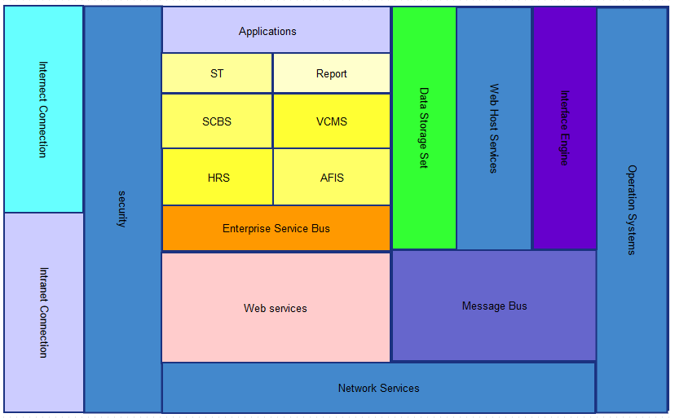
Technical Reference Model

Slide 36
Technical Principles
Model Name | Technical Principles | Best Practise
Internet/Intranet | The appropriate security measures must be put in place to ensure security and privacy protection. | HTTP,FTP,Email Service
Security | The appropriate security measures must be put in place to ensure security and privacy protection | C2 Firewall Service Norton Security Service
Applications(VCMS,ST,SCBS,etc) | Reuse everything that can be reused. Design and produce with reusability in mind. | Oracle-Java programming best practise
Data Storage Set | Reuse everything that can be reused. Design and produce with reusability in mind. | Oracle Database group
ESB,IE,MessageBus,Web Service | Information from across all the regional units, customers and port operators should be integrated. | Json 1.0 XML Message Queue

Slide 37
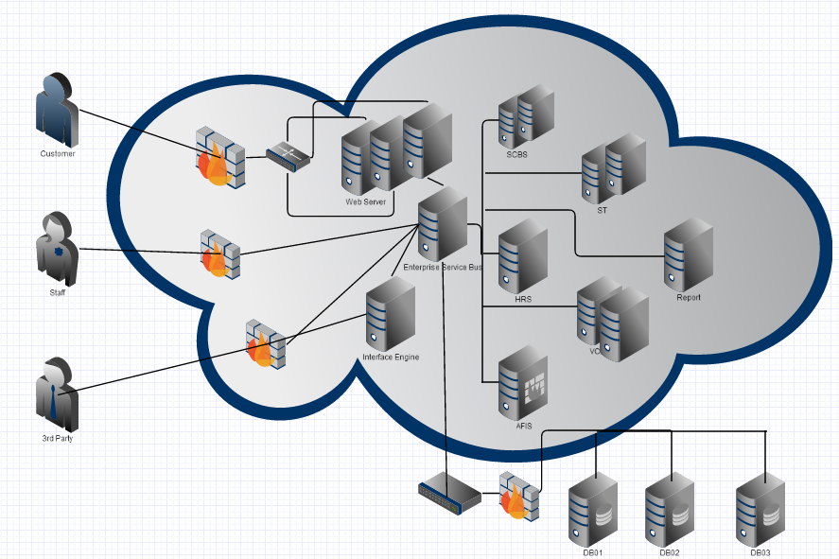
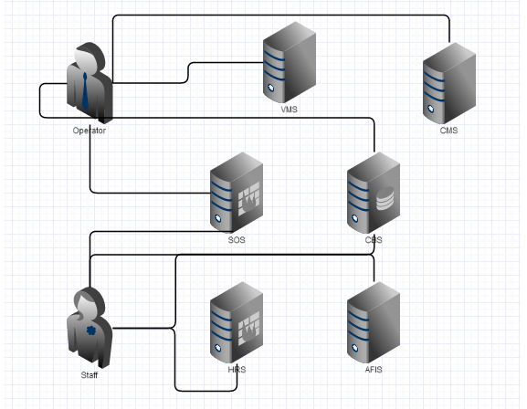
Architecture Current to Target
Target
Current

Slide 38
Gaps
Gap | Description | Current State | Future State | Importance/Benefit | Address by Architecture
Gap 1 | System security | No firewall found | Everything will hide under firewalls | Increase security | Technical
Gap 2 | Network latency | Not mention LB not | Will include in all web servers | Increase performance and usability | Technical
Gap 3 | VMS and CMS tend to have unscheduled downtime | 10%-15% unscheduled downtime always happen | System availability should reach 99.97% | Unscheduled downtime will reduce usability | Technical
Gap 4 | VMS and CMS were developed based on old technology | Nobody can maintain that system | Will use Java to develop and follow the java standard, easy to maintain | Easy to maintain and enhance the system | Technical

Slide 39
Opportunity and Solution

Slide 40
Initiatives
Initiatives | Priority
Re-engineer existing business processes | High
Establish more customer focused services to improve customer satisfaction. | High
Re-structure application systems | High
Provide interface for internal/external system to integrate. | Medium
Improve performance and enhance security in systems. | High
Standardize data storage for system integration. | High
Adapt new technology to improve system stability and ease for maintenance. | Medium
Produce management report for marketing analysis and strategy change. | Medium
Procure new hardware. | Low

Slide 41
Gap and Potential Solution (Business)
Gap | Potential Solution
Too much manual intervention required. | Re-engineer existing business processes to reduce manual effort and improve business efficiency.
Integrate e-Business with partner and customer’s IT system | Revamp and consolidate SOS and CBS. Revamp and consolidate VMS and CMS. Integrate internal systems to improve business process efficiency.
Focus on customer service is not enough | Provide customer registration. Provide online order submission and order status tracking. Provide online shipment tracking. Accelerate process for repeat orders.
Inaccuracy in sales report and transaction data. | To provide management report from consolidated system for better marketing analysis and decision.
Lack of management and monitoring in cooperation with local operators of tow-heads and port operators | Enhance existing systems to manage tow-heads operators and port operators. Keep track of co-operators to help to make engagement and manage cost.

Slide 42
Gap and Potential Solution (Information)
Gap | Potential Solution
Lack of knowledge in SOS system | Study the implementation of SOS. Gather requirement of SOS before revamping the system.
Legacy data from SOS system | Proper data migration to move the data to new system.
Data are stored with different standard in different systems | Standardize the data storage. To develop a common data dictionary as guideline.
Lack of consistency in container and vessel optimization decision | Centralize and standardize the optimization algorithm for organizing container.
Tow-head operator information is not managed | To capture tow-head operator details information in system.

Slide 43
Gap and Potential Solution (Application)
Gap | Potential Solution
Develop centralized SCBS system by consolidating and revamping SOS and CBS system | Develop the required system Implement system failover to ensure system high availability.
Develop centralized VCMS system by consolidating and revamping VMS and CMS system | To develop the required system To include tow-head operator management functions. To implement system failover to reduce the unscheduled downtime.
Container Movement prediction engine requires high computational load and it would affect the performance of VCMS. | Separate the Container Movement prediction engine. Deploy the engine in another distributed server. To provide the remote method invocation to VCMS.
Integration to SCBS for sophisticated customer’s procurement system | Develop a set of Web Services in SCBS for integration.
Integration to VCMS for Port Operators and internal applications | Develop a set of Web Service in VCMS for Port Operators to integrate. Develop another set of Web Service in VCMS for internal system to integrate.

Slide 44
Gap and Potential Solution (Application) continued…
Gap | Potential Solution
Online RFQ and order submission is not supported | Integrate SGLines Web site with SCBS to allow customer registration. Integrate SGLines Web site with SCBS to allow customer to submit RFQ and order online from a new Web storefront. Customize the Web contents for different customer type and country. Support different types of browsers.
Generating management report would impact VCMS performance | Replicate data for VCMS system using DB feature and set the replicated data to be read only. Access replicated DB to generate management report.
Order process is not fully automated. | Allow customer to continue to place order after RFQ with the details stated in RFQ. Integrated SCBS and VCMS using Web Services provided for internal use to automate RFQ and order process.

Slide 45
Gap and Potential Solution (Technology)
Gap | Potential Solution
VMS and CMS were developed based on old technology | Adapt new technology when developing the consolidated VCMS system.
VMS and CMS tend to have unscheduled downtime | Improve application architecture when developing the VCMS system. Improve code quality for VCMS development. Emphasize QA and plan sufficient review and testing to ensure the quality for the mission critical system. To implement system failover to reduce the unscheduled downtime.
Network latency | Increase network bandwidth. Separate Web Servers for transaction from staff and customer. Install load balancer on top of Web Servers.
System security | Install and configure firewall for systems Separate Web Servers for transaction from staff and customer. Require staff to use signed Java applets for secured login and encrypted client side processing.

Slide 46
Migration Plan

Slide 47
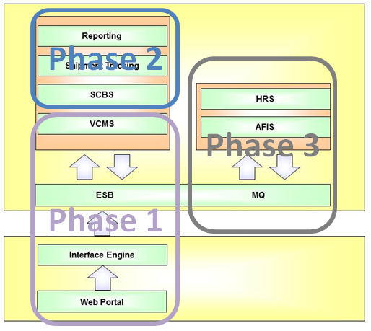
Transition Artifacts

Slide 48
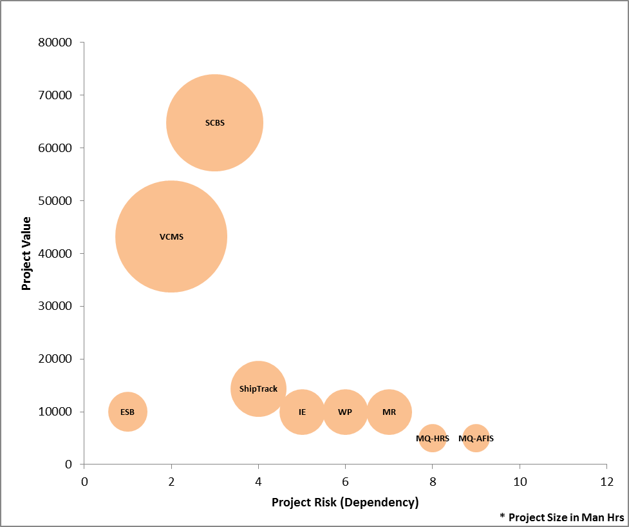
Migration Plan (1)
Cost and Risk
 | Projects | Ownership
Phase 1 | ESB | IT/Operations
 | VCMS | Container Management Team
 | IE | IT/Operations
 | Web portal | Container Management Team
 | Reports | Container Management Team
Phase 2 | SCBS | Order Processing Team
 | ShipTrack | Order Processing Team
 | IE | IT/Operations
 | Web portal | Order Processing Team
 | Reports | Order Processing Team
Phase 3 | MQ HRS | HR & Finance Team
 | MQ AFIS | HR & Finance Team
 | IE | IT/Operations
 | Web portal | HR & Finance Team
 | Reports | HR & Finance Team

Slide 49
Migration Plan (2)
Implementation Timeline

Slide 50
Governance

Slide 51
Governance Management Structure
Enterprise Architecture Governance
CIO
Architecture Planning and Development
Architecture Implementation
Architecture Deployment
Chief Architect
Architecture Board
Service Strategy and Review Team
aligns
Project Management Office
aligns
guides
reviews
guides
IT and Operations Team
guides
IT Outsourcing Management
Enterprise Architects
Supports
Project/Risk Management
Operational Systems
Solution Architects
Enterprise Architecture Projects
Conformance
Enterprise Continuum
Architectures
Processes
Solutions
SLAs/OLAs
Regulatory Requirements
Authority Structures
Organizational Standards
Notes:
Centralized EA approach

Slide 52
Architecture Compliance Review Process
Raise Architecture Review Request
Mandated by Architecture Board Policies
Identify Responsible Organization
Architecture Review Coordinator: 1) Identify responsible department 2) Identify project principal
Determine Scope of Review
Architecture Review Coordinator: 1) Identify other departments involved 2) Understand where system fits in corporate framework
Tailor Checklists
Lead Architect: 1) Determine appropriate checklist questions
Schedule Architecture Review Meeting
Architecture Review Coordinator Chief Architect 1) Collaborate to setup meeting
Interview Project Principals
Lead Architect Project Leader Customers 1) Using checklists
Analyze Completed Checklists
Lead Architect 1) Review against corporate standards 2) Identify and resolve issues 3) Determine recommendations
Prepare Architecture Review Report
Lead Architect
Present Review Findings
Lead Architect 1) To customer 2) To Architecture Advisory Board
Accept Review and Sign off
Architecture Advisory Board Customer
Identify Lead Architect (From Solution Architects)
Architecture Review Coordinator
* An exception may be raised if a non or partial compliance requires further review

Slide 53
Architecture Exception and Vitality Process
Raise Architecture Exception
Identify Relevant Architecture Artifacts
Schedule Architecture Review Meeting with Project Implementation Team
Determine Validity of Exception with respect to the Artifacts
If Exception is Invalid, Flag Exception as Non-Conformance and Requires Rectification
If Exception is Valid, Escalate Exception to Architecture Advisory Board
Architecture Advisory Board to Determine if the Exception can be made.
Raise Change Request for Architecture Artifacts
If Exception can be made, approve the Exception
If Exception is a result of Architecture Artifact errors, determine the impacted Artifacts.
Flag Exception as Non-Conformance and Requires Rectification if Architecture Artifacts are accurate and correct and that Exception cannot be made

Slide 54
Change Management Process
Raise Change Request
Classify Architectural Change into Categories
Simplification
Re-Architecting
Incremental
Handle using Change Management Technique
Go through Partial Re-Architecting
Go through entire ADM cycle
Impact Analysis
Review Change with Architecture Advisory Board
Approve Change
Implement Change on EA
Update Schedule and Plan

Slide 55
Staff
Enterprise Architecture Team
Management
Communicates the importance of EA
Proposal and Approval of EA related tasks
Supervision
Feedback and contribute domain knowledge to EA team.
EA team coordinate with staff to understand their business or work process
Promote the use of EA to staff
Promote the use of EA to Management
Provide metric results to management
Report the EA effectiveness to management

Slide 56

Thank You

